Slide 1
Zombie Pegasus Studios
Kaitlyn Childers, Junior, Software Engineering
Elijah Holt, Senior, Software Engineering
Jeromy Swann, Senior, Software Engineering

Slide 2
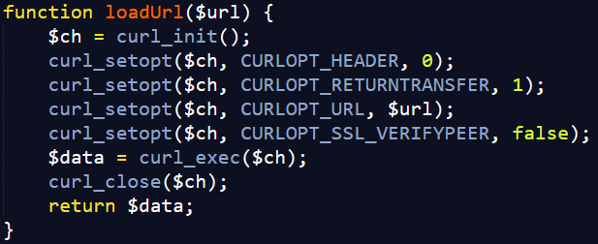
Technologies Used
Backend
PHP
Curl
String functions
strtolower()
explode()
strpos()
substr()

Slide 3
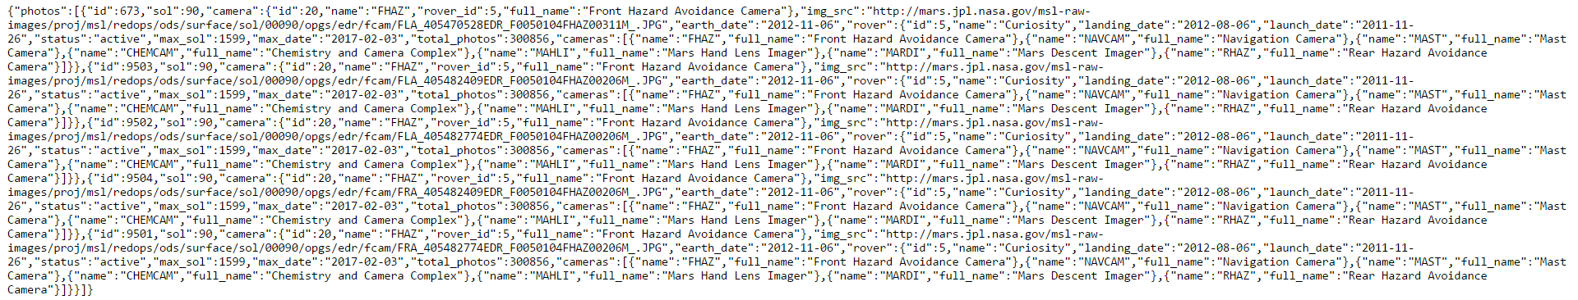
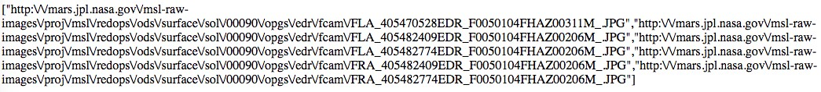

Slide 4
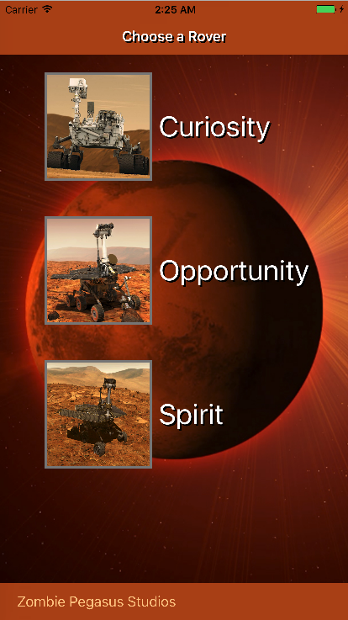
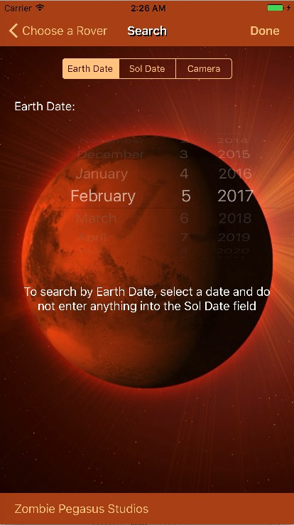
Technologies Used
iOS App
Multi-view application written in Swift
Receives JSON responses from PHP server
Uses TableView and CollectionView

Slide 5
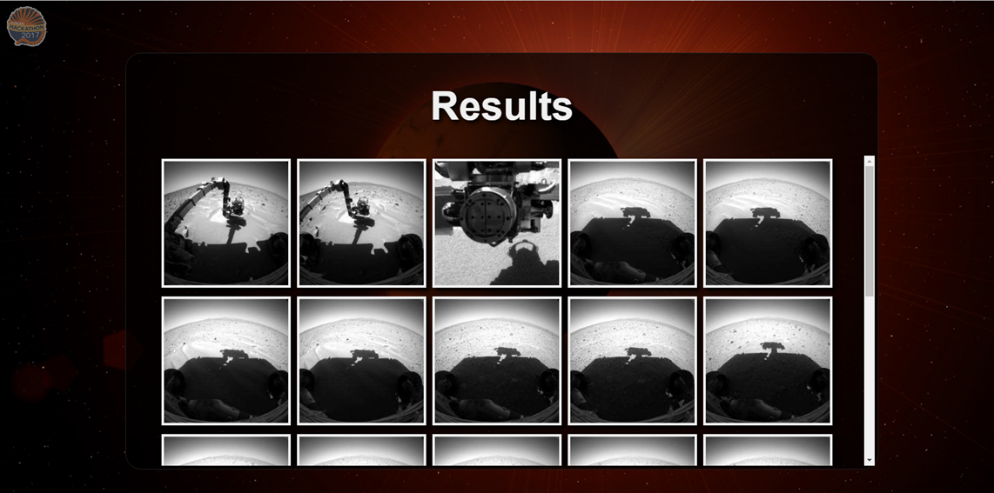
Technologies Used
Frontend Website
HTML/CSS
JavaScript
jQuery
Interconnectivity
JSON
XAMPP/Apache server

Slide 6
Difficulties Overcome
Jeromy
First time using JSON
Elijah
First time using PHP
Kaitlyn
First time writing an iOS app receiving JSON data
All
First time using a web API

Slide 7
Demo

